Slide 1
Investigating Explainable Methods for LLMs Case Study: Emotionally Aware Chatbot
Presented by:
Domenico Pazienza, Leonardo Ercolani
Date: 12/12/2024

Slide 2
What is the project about?
Goal
Goal:
Analyze explainable AI techniques to interpret the decisions made by the emotion detection model.
Analysis and Implementation of explainable methods
Fine-tuned conversational models for emotion detection
Key Features:

Slide 3
Why this project?
Existing LLMs often lack transparency
Regulatory Compliance:
Adhering with GDPR and European regulatory frameworks (AI Act)
Bridging the knowledge gap between human/computer interaction

Slide 4
Project Structure
Literature Review and Comparative Analysis of Explainable Methods for LLMs
Implementation of an Emotion Recognition Model
Model Explanation
Fine-Tuning and Evaluation

Slide 5




System Architecture
Input Handling:
Text input: Direct processing.
Voice input: Speech-to-text conversion
Emotion Analysis:
Emotion classifier pipeline (BERT)
Response Generation:
Generate an empathetic response based on the detected emotion
Output Delivery:
Response text returned to the user.

Slide 6

Datasets
GoEmotions:
Annotated with 27 emotions + neutral.
Source: Curated from Reddit comments.
Statistics:
58,000 annotated examples.
Balanced across multiple emotion categories.
DailyDialog:
Multi-turn conversational dataset.
Annotated for emotions and dialogue acts.
Statistics:
13,000 multi-turn dialogues.
Includes annotations for intent and sentiment.

Slide 7
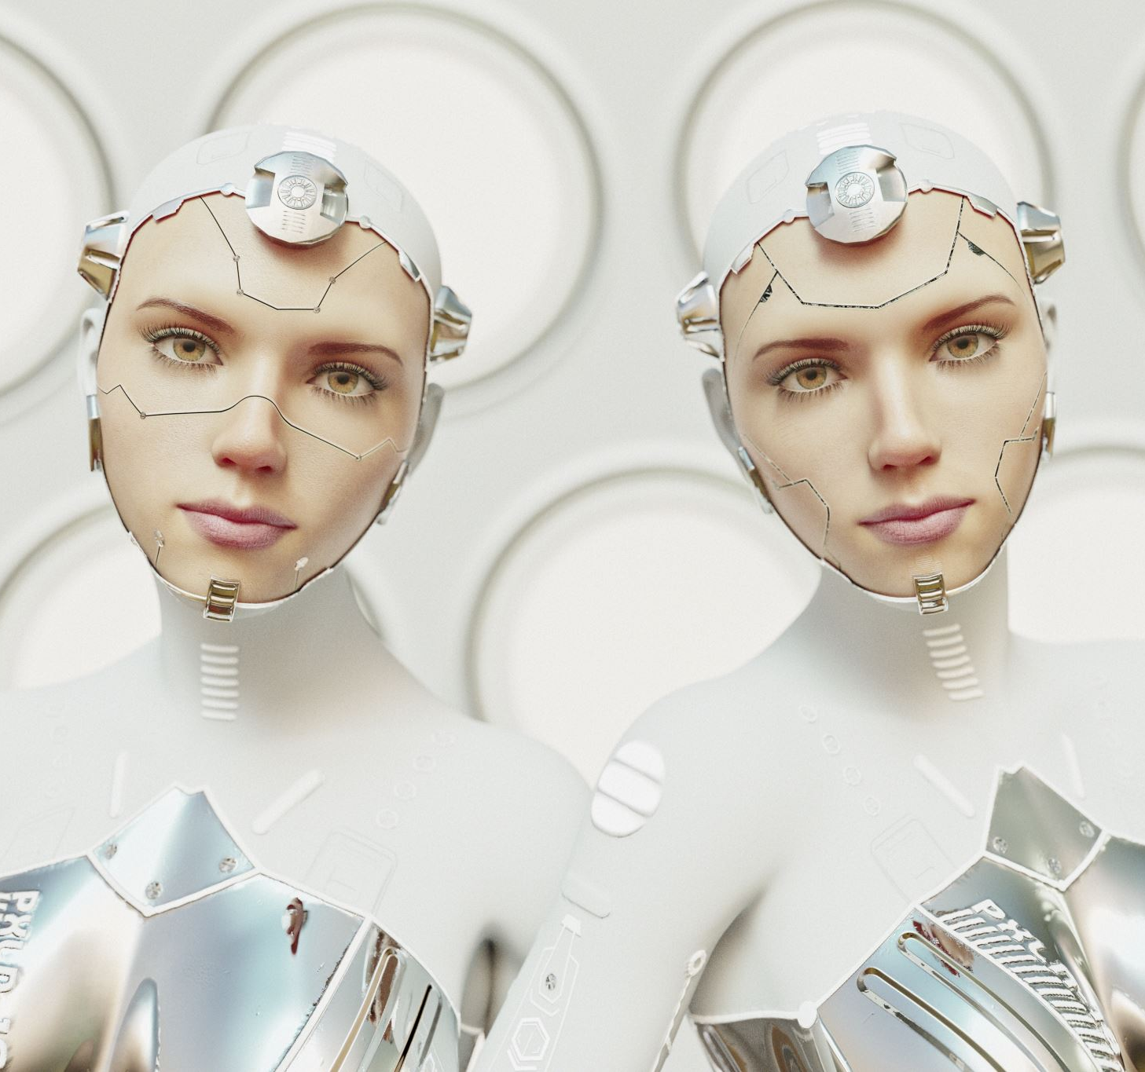
Model Choices
Emotion Detection:
Model: BERT fine-tuned on GoEmotions.
Output: Probabilities for each emotion.
Response Generation:
Model: using DialoGPT or BlenderBot Fine-Tuning on DailyDialog.

Slide 8

Fine-Tuning Process
Dataset: DailyDialog (context-response pairs).
Steps:
Tokenize and preprocess conversations.
Train using transformers library.
Evaluate and save the fine-tuned model.

Slide 9
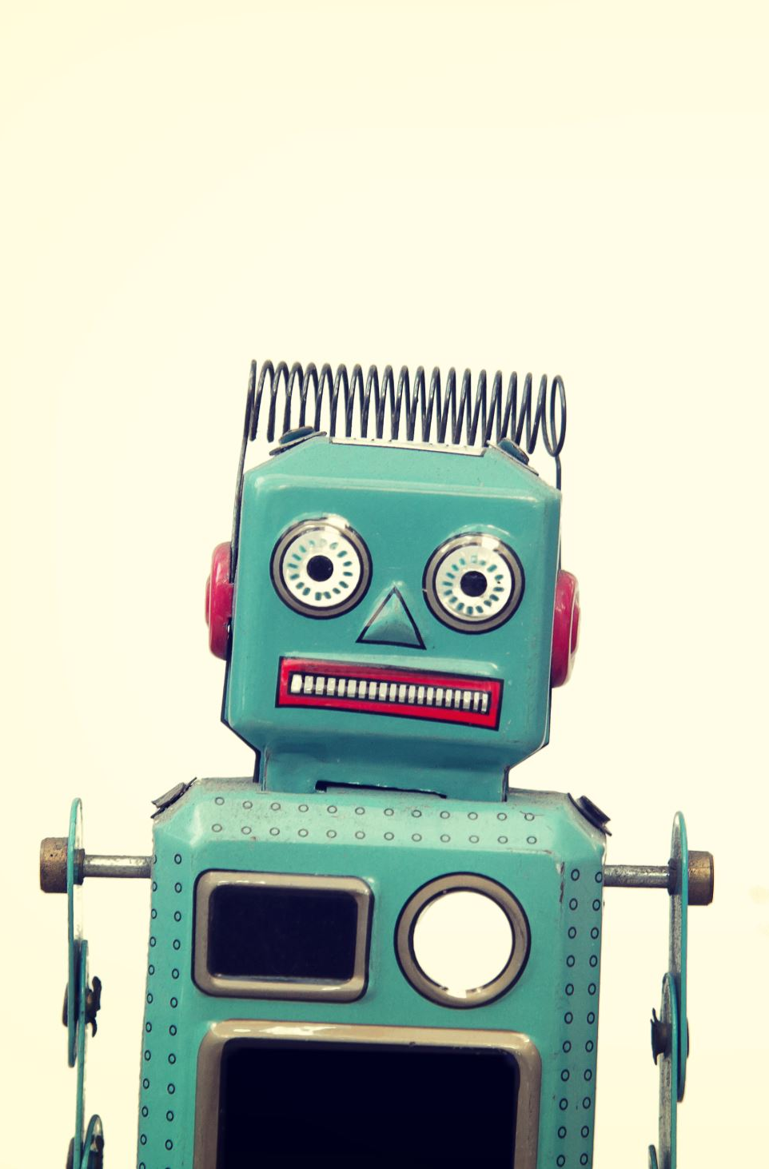
Live Demonstration
Input examples:
"I passed my exam!"
Detected Emotion: Joy (95%).
Bot Response: "Congratulations! You worked hard for this!"
"I feel so sad today."
Detected Emotion: Sadness (85%).
Bot Response: "I'm sorry to hear that. Want to talk about it?"

Slide 10
Explanations
Feature-Attribution Based Explanations
Attention-Based Explanations
Example-Based Explanations

Slide 11
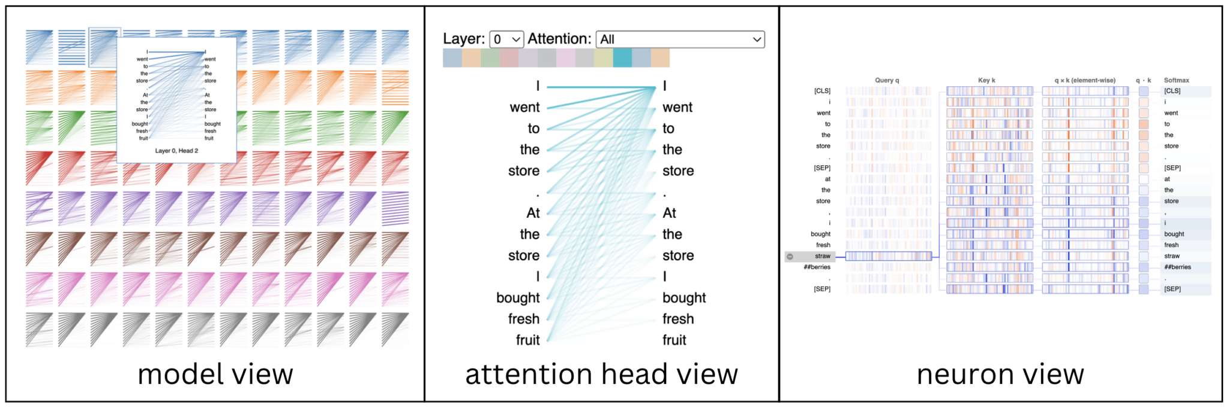
BERTViz
https://www.comet.com/site/blog/explainable-ai-for-transformers/

Slide 12




Key Challenges
Balancing response diversity and coherence.
Selecting the right method
Managing computational requirements for fine-tuning.
Interpreting ambiguous results

Slide 13
Thank you for your attention
Questions?
References:
BertViz: https://www.comet.com/site/blog/explainable-ai-for-transformers/
Zhao, H., Chen, H., Yang, F., Liu, N., Deng, H., Cai, H., ... & Du, M. (2024). Explainability for large language models: A survey. ACM Transactions on Intelligent Systems and Technology, 15(2), 1-38.

